Slide 1
Hypothesis Testing
Testing Outlandish Claims

Slide 2
Learning Objectives
Be able to state the null and alternative hypotheses for both one-tailed and two-tailed tests
Differentiate between a significance level and a probability level
State the five steps involved in hypothesis testing

Slide 3
Big Idea to Remember
Don’t mess this idea up!!!!!!!!
We Reject
We Fail to Reject
We never Accept anything.

Slide 4
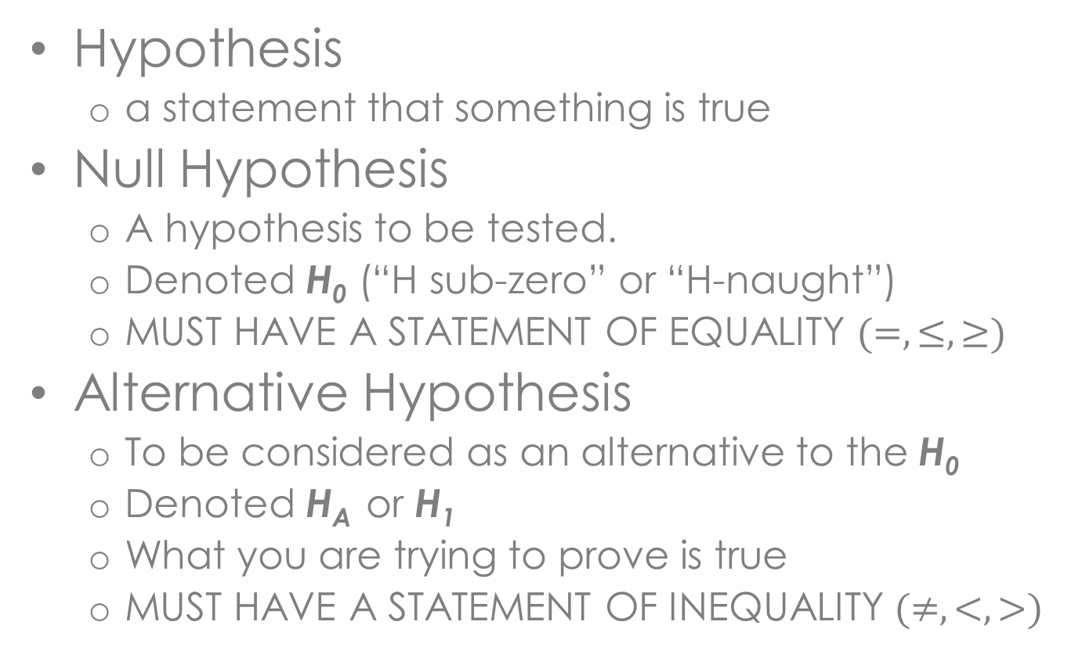
Key Definitions
Hypothesis
  a statement that something is true
Null Hypothesis
  A hypothesis to be tested.
  Denoted H₀ (“H sub-zero” or “H-naught”)
  MUST HAVE A STATEMENT OF EQUALITY $(=,≤,≥)$
Alternative Hypothesis
  To be considered as an alternative to the H₀
  Denoted H_{A} or H₁
  What you are trying to prove is true
  MUST HAVE A STATEMENT OF INEQUALITY $(≠,<,>)$
Notes:
Null the person is innocent you are the prosecutor so you have to prove guilt so null (innocence) assumed

Slide 5
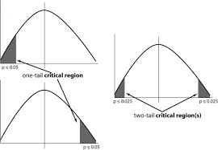
Types of Statistical Tests
Left Tailed
Right Tailed
Two-Tailed

Slide 6
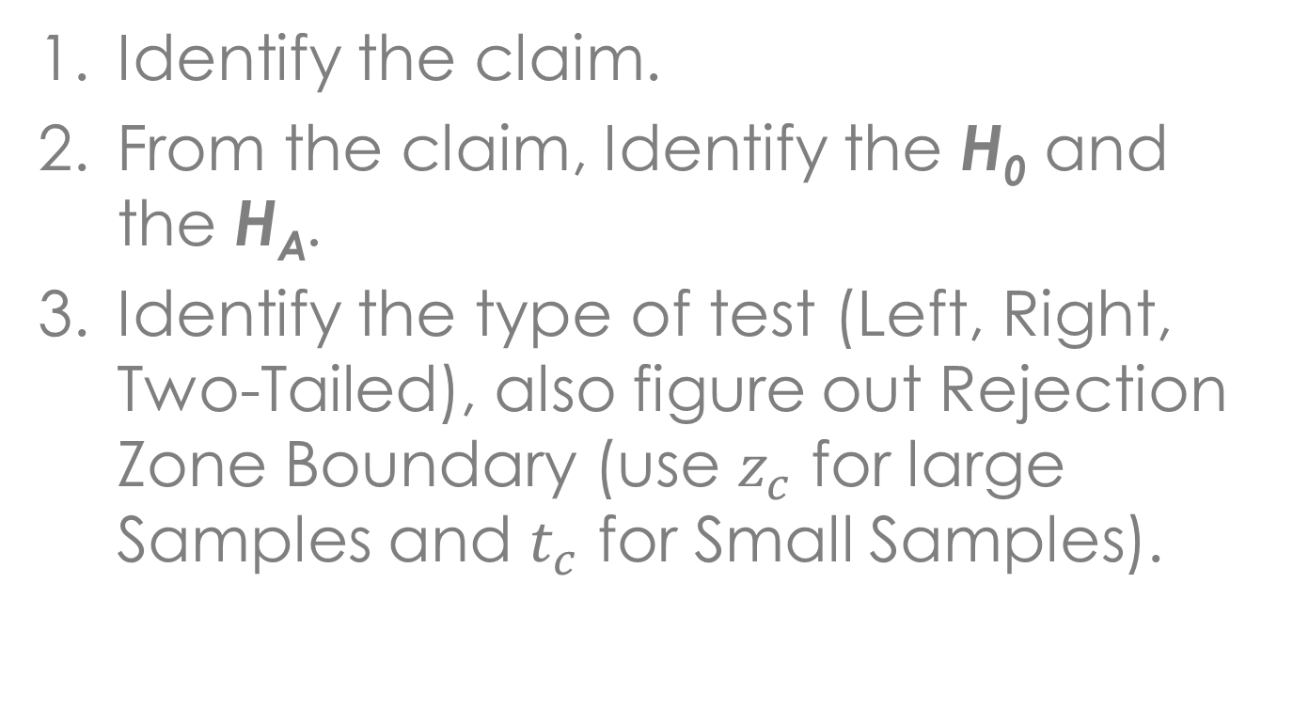
Setting up a Test
Identify the claim.
From the claim, Identify the H₀ and the H_{A}.
Identify the type of test (Left, Right, Two-Tailed), also figure out Rejection Zone Boundary (use $z_{c}$ for large Samples and $t_{c}$ for Small Samples).

Slide 7
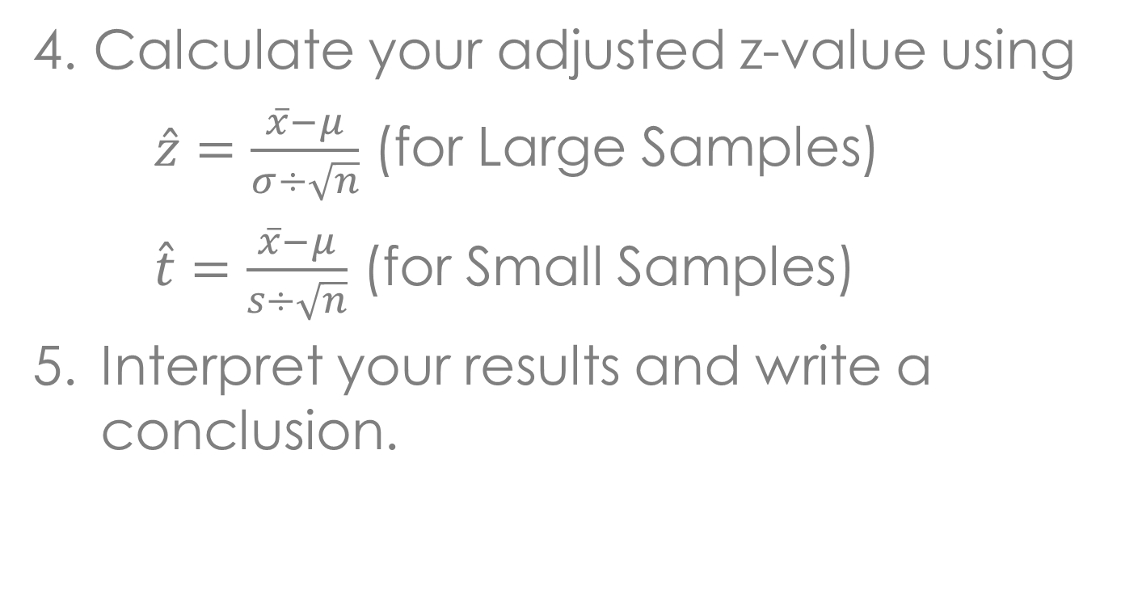
Calculations for the Test
Calculate your adjusted z-value using
$\hat{z}=\frac{\overline{x}−μ}{σ÷\sqrt{n}}$ (for Large Samples)
$\hat{t}=\frac{\overline{x}−μ}{s÷\sqrt{n}}$ (for Small Samples)
Interpret your results and write a conclusion.

Slide 8
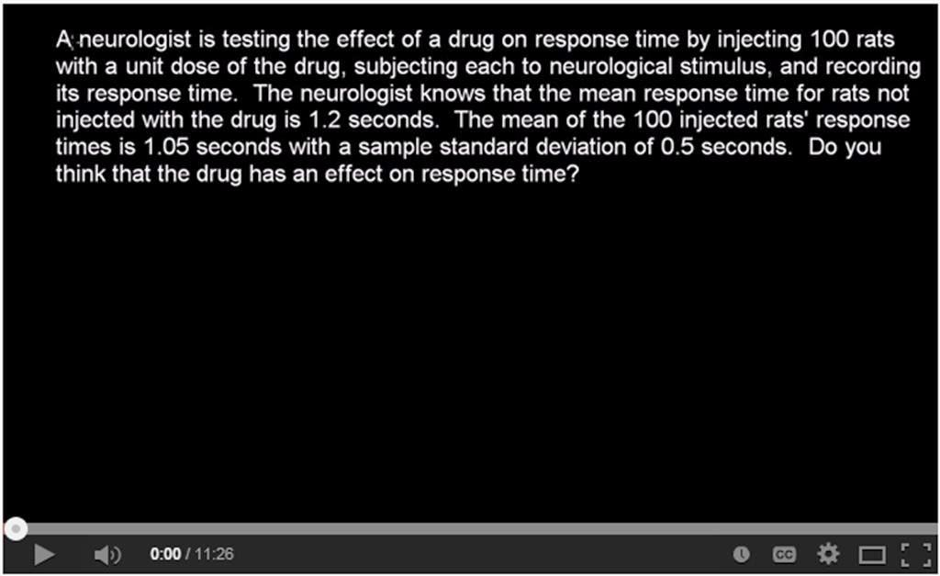
Video Example

Slide 9
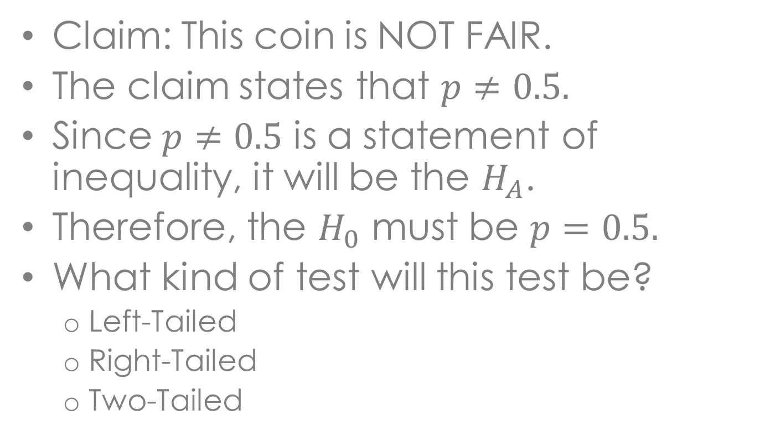
Written Example
Claim: This coin is NOT FAIR.
The claim states that $p≠0.5.$
Since $p≠0.5$ is a statement of inequality, it will be the $H_{A}$.
Therefore, the $H_{0}$ must be $p=0.5.$
What kind of test will this test be?
  Left-Tailed
  Right-Tailed
  Two-Tailed

Slide 10
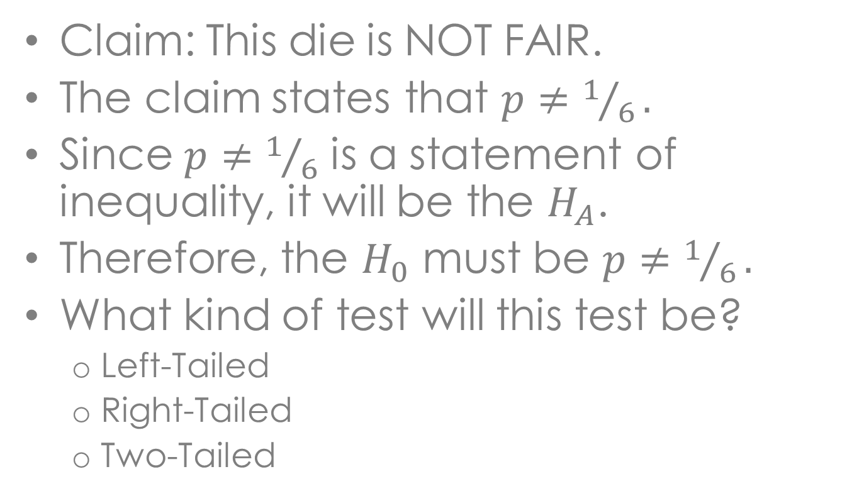
Another Example
Claim: This die is NOT FAIR.
The claim states that $p≠1/6.$
Since $p≠1/6$ is a statement of inequality, it will be the $H_{A}$.
Therefore, the $H_{0}$ must be $p≠1/6.$
What kind of test will this test be?
  Left-Tailed
  Right-Tailed
  Two-Tailed

Slide 11
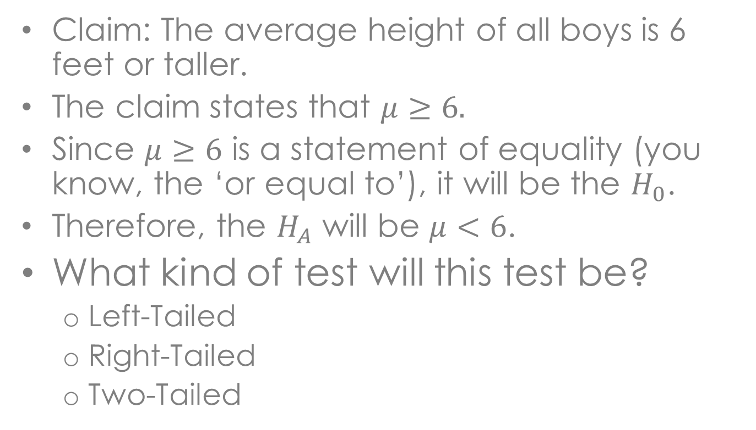
Another Example
Claim: The average height of all boys is 6 feet or taller.
The claim states that $μ≥6.$
Since $μ≥6$ is a statement of equality (you know, the ‘or equal to’), it will be the $H_{0}$.
Therefore, the $H_{A}$ will be $μ<6$.
What kind of test will this test be?
  Left-Tailed
  Right-Tailed
  Two-Tailed

Slide 12
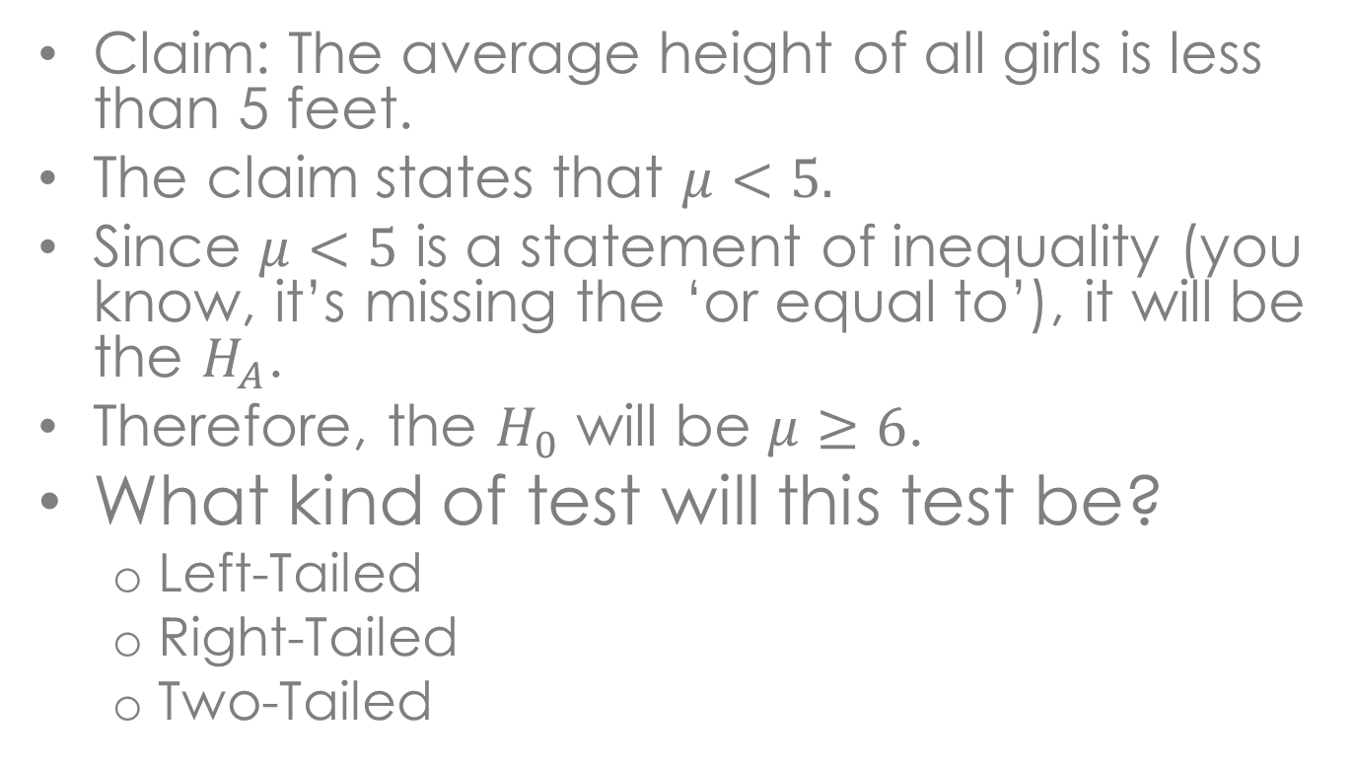
Another Example
Claim: The average height of all girls is less than 5 feet.
The claim states that $μ<5.$
Since $μ<5$ is a statement of inequality (you know, it’s missing the ‘or equal to’), it will be the $H_{A}$.
Therefore, the $H_{0}$ will be $μ≥6$.
What kind of test will this test be?
  Left-Tailed
  Right-Tailed
  Two-Tailed

Slide 13
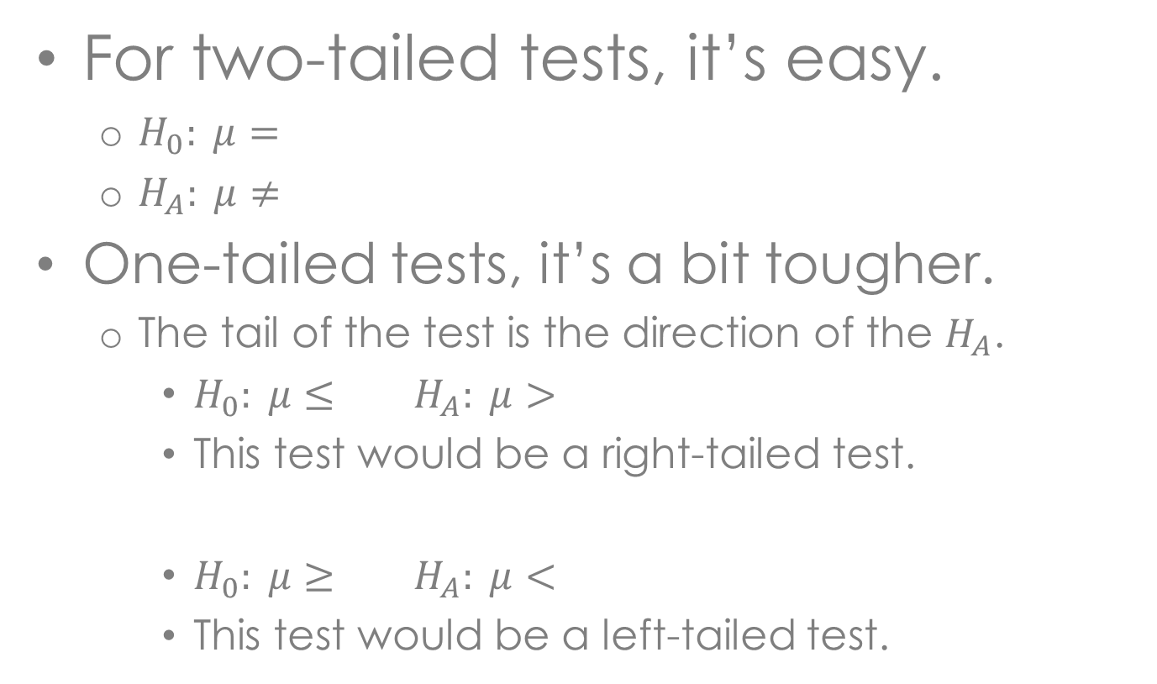
Which direction?
For two-tailed tests, it’s easy.
  $H_{0}: μ=$
  $H_{A}: μ≠$
One-tailed tests, it’s a bit tougher.
  The tail of the test is the direction of the $H_{A}$.
    $H_{0}: μ≤$ $H_{A}: μ>$
    This test would be a right-tailed test.
    $H_{0}: μ≥$ $H_{A}: μ<$
    This test would be a left-tailed test.

